Slide 1
Data Visualization Workshop Session 1: Telling Stories With Data
Matthias Shapiro
@politicalmath
matthias.shapiro@outlook.com
Notes:
Hey and welcome to the Data Visualization Workshop. Thanks for being here. In this workshop we will cover a huge range of material and topics, but it will all point back to the same core: Using data to tell stories.
I’m Matthias Shapiro. If you’re on Twitter, you can follow me at politicalmath. Warning: I’m on Twitter all the time and I am a horrible person. If you’re on fire for some reason, you can email me at Matthias.Shapiro@outlook.com.
That’s a joke, lighten up people. This is going to be a long day.

Slide 2
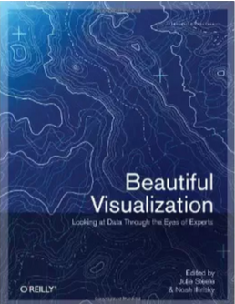
Who Is This Loser?
Authored dozens of data visualizations
CNN, ABC News, Fox News, CSPAN, New York Times, The Atlantic, IEEE, IFTA, Ignite
Presented on data visualization internationally
Wrote the book on data visualization
Microsoft Technical Educator
Windows and Windows Phone
Cross platform design and development
Notes:
OK…. First you should probably know a little bit about me. Up until last week, I was living on the street corner over there, drunk and hopeless. I’m kidding, I can’t afford that street corner.
I am deeply, deeply passionate about data visualization. Since I started doing data visualization in 2009, I’ve authored dozens of data visualizations. I’ve talked about data visualization on CNN, ABC News, Fox News, and CSPAN. I’ve been featured in the New York Times, The Atlantic, I’ve spoken at IEEE… anyone know what IEEE is? OK. I’ve spoken internationally at a half dozen industry conferences on data visualization and I even wrote the book on it. A book. A chapter in this book, Beautiful Visualization, which was one of the best selling technical books for months after it was released.
Also, I spent a few years working for Microsoft as a technical educator (or, as we call ourselves, technical evangelist) teaching programmers how to create apps for Windows, Windows Phone, and specializing in what we call cross platform development… which means creating applications that run smoothly across several platforms from Windows to Android to iOS. I built curriculum that was delivered to thousands of programmers to teach them how to build betters apps. The important thing here isn’t the specific technologies… it is that I’m not only passionate about data visualization, I’m passionate about teaching people about technical things.

Slide 3
What to Expect When I’m Projecting
Session 1 – the basics
Importance of data visualization
Overview of skills and tools
Basic visualization algorithms
Session 2 – the data
How to find and import data
Using Excel to manipulate and analyze data
Basic charting for trends and patterns
Lab 1
Collect a simple data set
Excel basics
Create simple visual, begin design process
Lab 2
Collect a complex data set
Analyze data in Excel
Use understanding of data to begin telling a story
Notes:
So what can you expect over the course of this day?
This day will alternate between lectures and labs. We’ll talk about some aspect of data and visualization and then we’ll do a lab to try to reinforce some of those concepts. The labs are meant to be done in 60 minutes or less, but if you don’t get them done, don’t worry. The real goal of the labs is for you to get comfortable with the tools and the concepts we’re talking about here. I want you to wake up tomorrow and feel like you could hit the ground running and start making some visuals.
In Session 1 (that is now) we’ll cover the basics of the course and the why of data visualization and give an overview of the skills and tools we’ll need to create visualizations. We’ll also do a bit of an overview of who is here, find out where you are on your visualization journeys. Then we’ll take a brief look at some of the algorithms that we’ll need as we move forward with our visualizations. Who here got a little… whew! … up the leg when I said algorithm? Well, for the rest of you, everything algorithm I cover here will be programmed into an Excel spreadsheet that you have in the digital materials we’re handing out.
For our first lab, I’m going to have you find a dataset, download it and pull it into Excel. There we will do some simple analysis on it and create a basic visual using some kind of imaging program.
In Session 2, we’re going to talk about finding and importing a range of data sets, some Excel techniques for managing that data, cleaning it up, analyzing it. Then we’ll cover the kinds of charting that Excel gives us for free and why we would use these charts.
In the second lab, we’ll collect and format a complex data set, analyze that data in Excel and use our understanding of that data and some quick visual representations of it to start telling a story about it.

Slide 4
What to Expect When I’m Projecting
Session 3 – visual types
Overview of visualization types and styles
Choosing a technology to achieve your styles
Session 4 – designing your visualization
Designing a visualization for publication
Sharing a visualization
Lab 1
Collect a simple data set
Excel basics
Create simple visual, begin design process
Lab 2
Collect a complex data set
Analyze data in Excel
Use understanding of data to begin telling a story

Slide 5
Agenda
Introduction to Data Visualization
The Importance of Story
The Data Artist
Tools and Algorithms
Notes:
And now that you hopefully know what is coming up, we can really dive into it. In this session, I’m going to start out with an intro to data visualization. I’ll talk about data and stories and how visualizations are great and everything, but the ones that really stick with us are the ones that tell the best stories. We’ll look at the tools and skills of what I’m going to call the “Data Artist” and finally, we’ll talk about the tools and algorithms that we’ll be using for the rest of the day.

Slide 6
Intro to Data Visualization

Slide 7
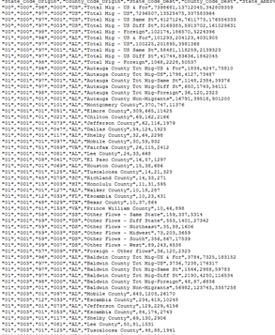
Swimming in Data

Slide 8
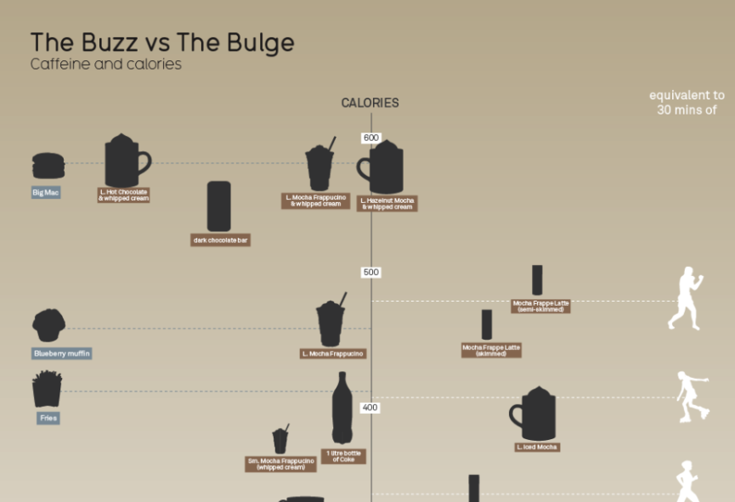
Swimming in Data

Slide 9
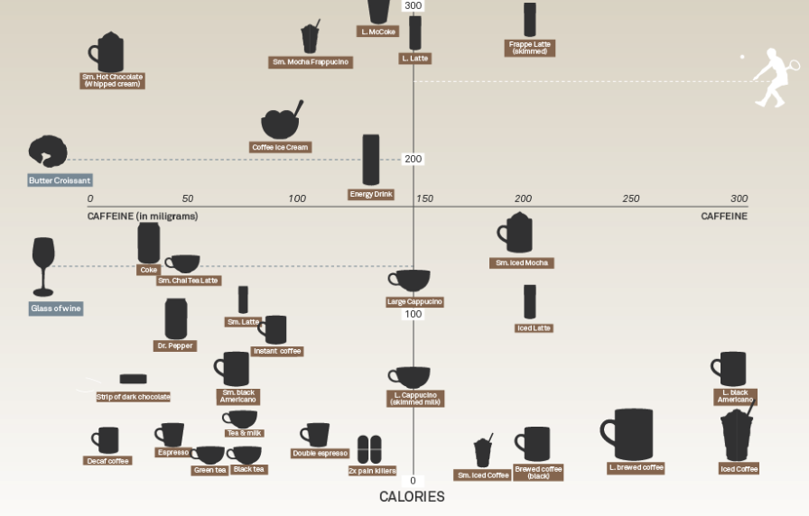

Slide 10
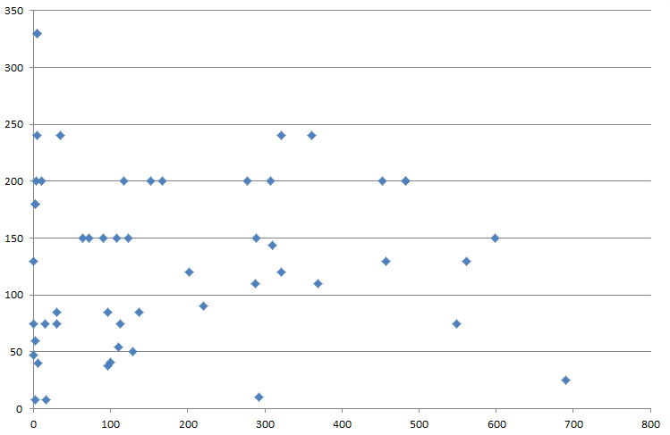
Charts vs. Visualization

Slide 11
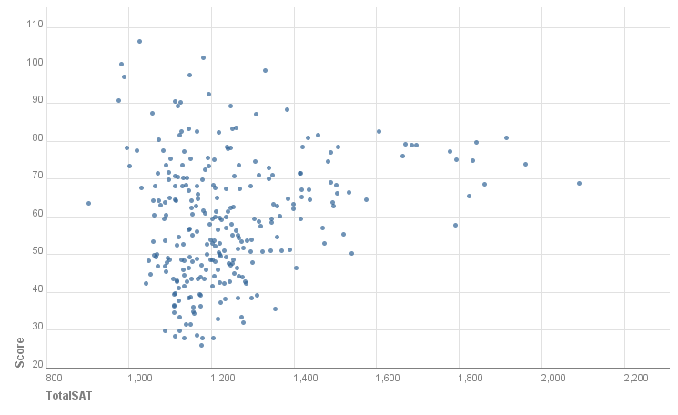
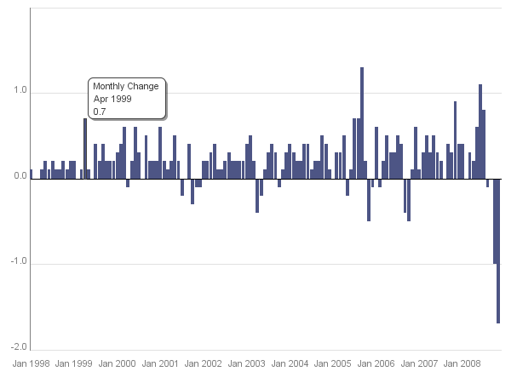
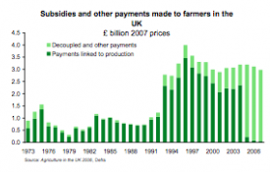
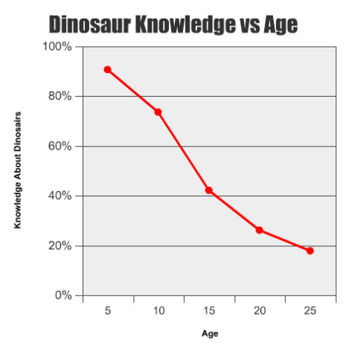
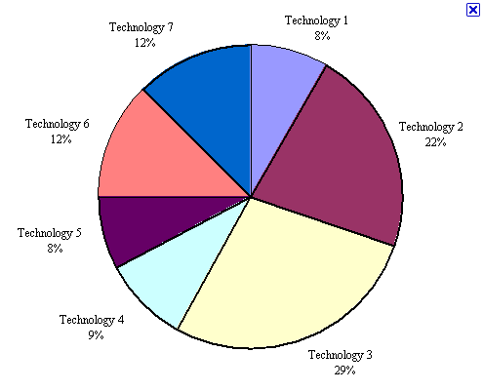
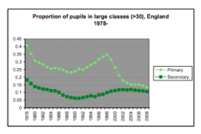
Charts vs Visualizations
Charts are good for some things

Slide 12
Public Steps of a Visualization
Set the stage (including topic)
Present the problem
Present the data visually
Conclude with impact

Slide 13
Behind the Scenes Steps of Visualization
Posing a question
Finding the data
Parsing & analyzing the data
Choosing a visual representation

Slide 14
The Importance of Story

Slide 15
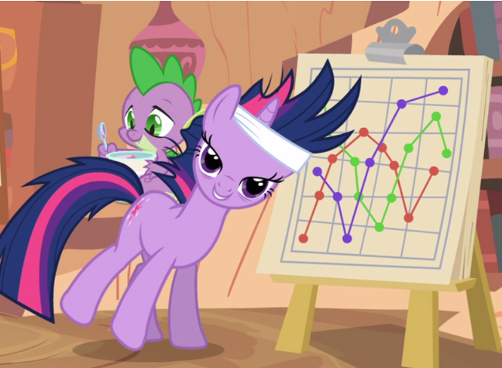
All Data Lives in a Context

Slide 16
Only The Story Makes Data Matter

Slide 17
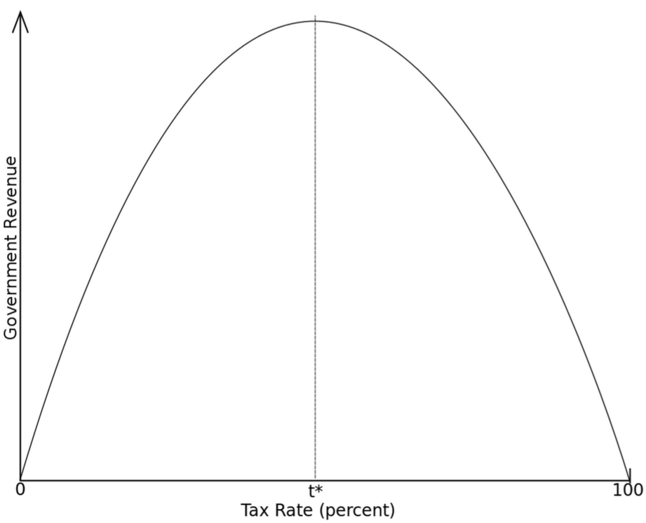
Humans Are Visual
Napkin Charts
The Laffer Curve

Slide 18
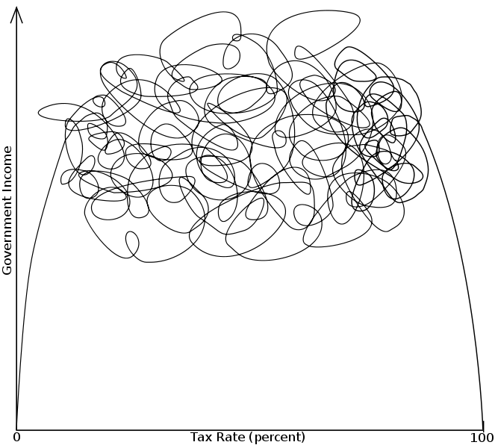
Humans Are Visual
Napkin Charts
The Laffer Curve

Slide 19
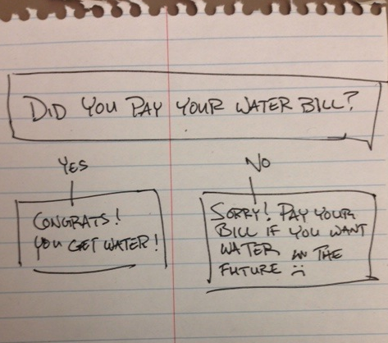
Humans Are Visual
Visuals can be simple or complex
The value is in the story & message
http://freebeacon.com/blog/explainer-if-you-dont-pay-your-bills-you-dont-get-stuff/

Slide 20
The Visualization Artist

Slide 21
Wrangling Data
Find and collect data
Sort, filter, parse
Select appropriate data for visualization
Abilities
Tools
Manage data by hand (easy)
Manage data using Excel (medium)
Manage data programmatically using R, Python, databases (advanced)

Slide 22
Designing Data
Layout / placement of data visuals
Color theory, selection
Typography
Abilities
Tools
Automated charting (easy)
Custom charting redesigned in imaging software such as Photoshop (medium)
Custom programmatic visuals (hard)

Slide 23
Communicating Data
Connect the appropriate data to a story
Set up problem in a short, memorable manner
Select visualization style to best communicate data
Abilities
Tools
Automated charting (easy)
Custom charting redesigned in imaging software such as Photoshop (medium)
Custom programmatic visuals (hard)

Slide 24
Where are you?
Design
Communication
Technical

Slide 25
By The End
You will be making charts (data wrangler)
You will turn those charts into visualizations (designer)
You will tell stories with those visualization (communicator)

Slide 26
Beware Young Padawan
You will be making charts (data wrangler)
You will turn those charts into visualizations (designer)
You will tell stories with those visualization (communicator)

Slide 27
Basic Algorithms

Slide 28
Basic Algorithms
NO DON’T LEAVE!
(there will be helpers)

Slide 29
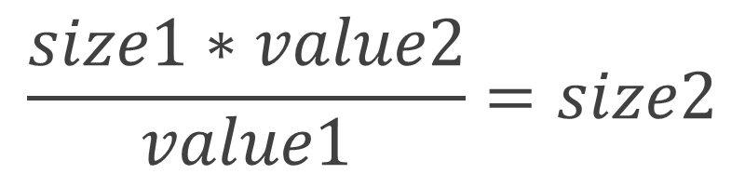
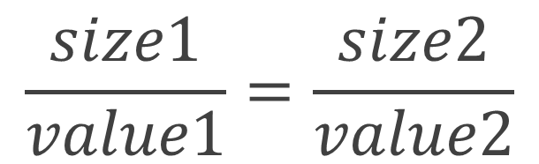
Simple Ratio
The essential equation for representing and comparing two values
All other visualization equations are a version of this
This is called a “ratio”
$$\frac{size1}{value1}=\frac{size2}{value2}$$
$$\frac{size1∗value2}{value1}=size2$$

Slide 30
Simple Ratio
Example: Votes (compare California votes to Texas votes in 2008 election)
Example 2: Show all the votes in the 2008 election in a chart

Slide 31
Choosing an Anchor Visual
Find a key data point in your visual (value 1)
Size the representation to fit that data point (size 1)
A good key data point is the largest value you will need to represent

Slide 32
Choosing an Anchor Visual
Show all the states & explain why I chose California as my anchor
Show the actual math steps

Slide 33
Anchor Visual Example
Find a key data point in your visual (value 1)
Size the representation to fit that data point (size 1)
A good key data point is the largest value you will need to represent

Slide 34
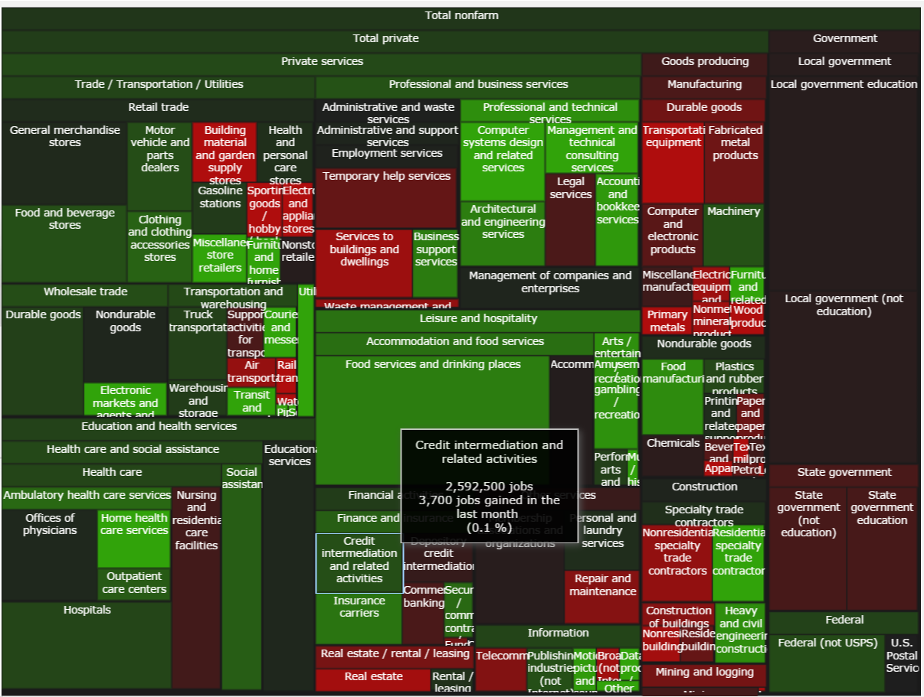
Area
An area is “width x height”
Lines and bars are 1D
Areas are 2D

Slide 35
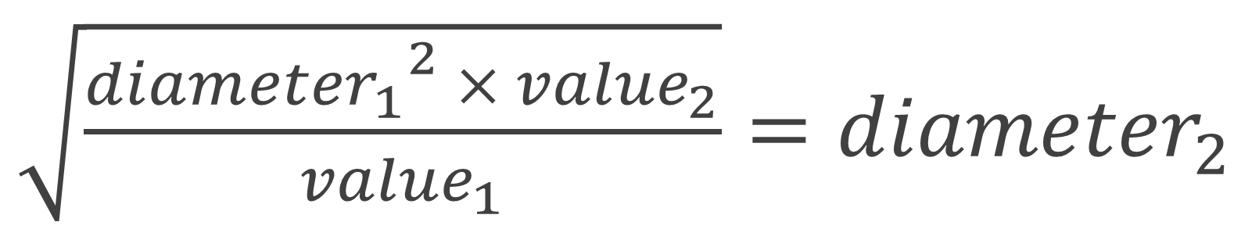
Area (including circles)
Circles are easy to create / render, but they resize based on the area equation.
Choose your anchor circle, measure the diameter
$\sqrt{\frac{{{diameter}_{1}}^{2} × {value}_{2}}{{value}_{1}}}={diameter}_{2}$

Slide 36
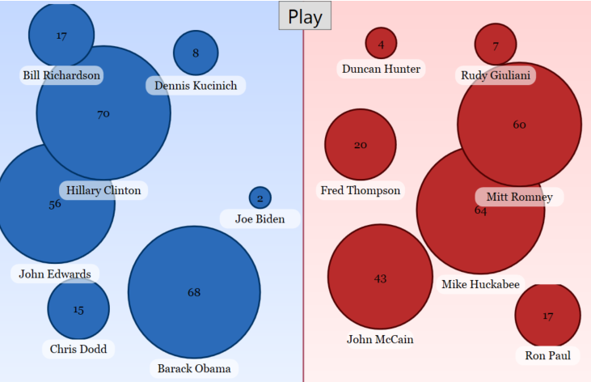
Area (including circles)

Slide 37
Colors (2 color)
Colors are invaluable, but the equation is somewhat complex
Choose a minimum value and a minimum color
Choose a maximum value and a maximum color
Compare the red, green, and blue values (see Excel worksheet)

Slide 38
Colors (2 color)
Show 2008 map example

Slide 39
Colors (3 color)
Sometimes 3 color visualizations are more valuable that 2 colors
Pick a minimum, maximum value
Pick a minimum, maximum, middle color
See Excel worksheet

Slide 40
Colors (3 color)
Show 2008 map example

Slide 41
Lab 1
Pull a data set
Sort and format
Create chart
Format into visualization

